Slide 1


Home Learning at Mapplewells

Slide 2
Home Learning
Home Learning
Accessible to all children and families.
Compliments the teaching that is taking place in school.
Promotes the development of independent learners.
Reinforces and consolidates key learning.
Weekly
Flexible

Slide 3
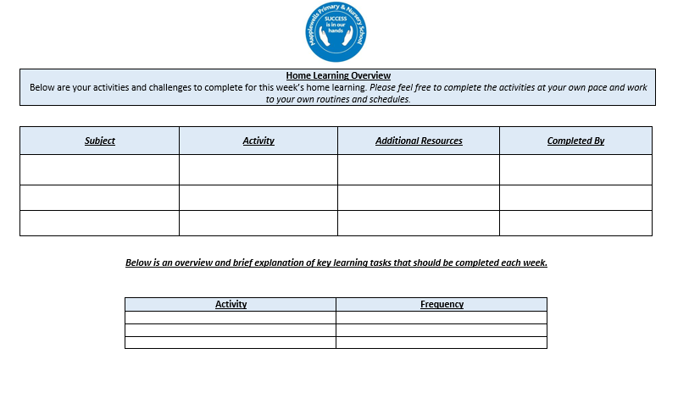

Slide 4
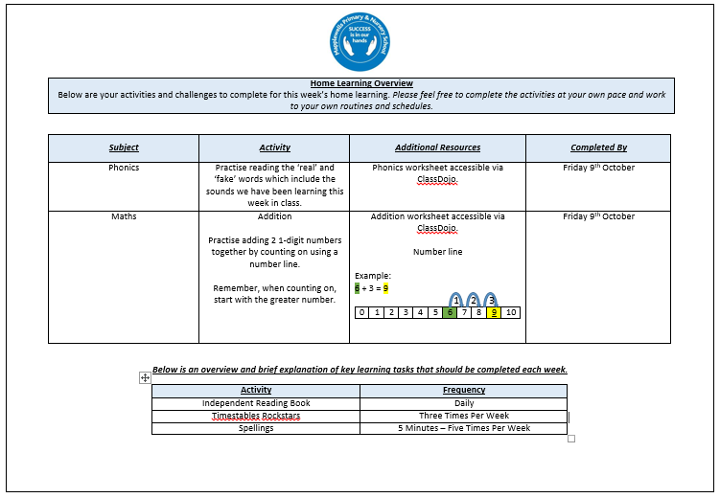

Slide 5


Friday’s
3:30pm

Slide 6
Home Learning at Mapplewells

