Slide 1
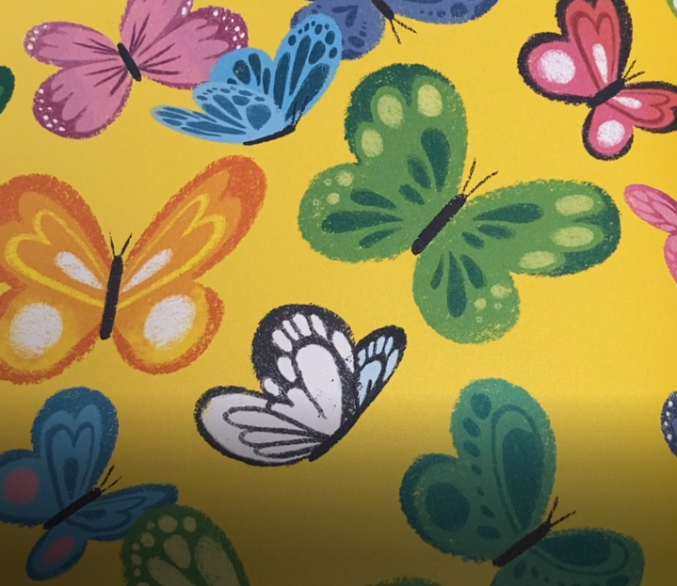
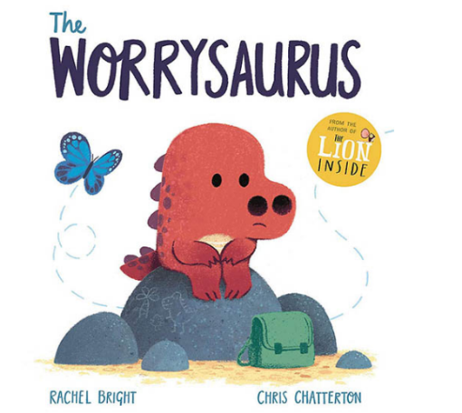


The Worrysaurus

Slide 2
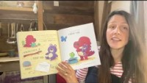
‘The Worrysaurus’
Written by Rachel Bright, illustrated by Chris Chatterton and published by Orchard Books.

Slide 3
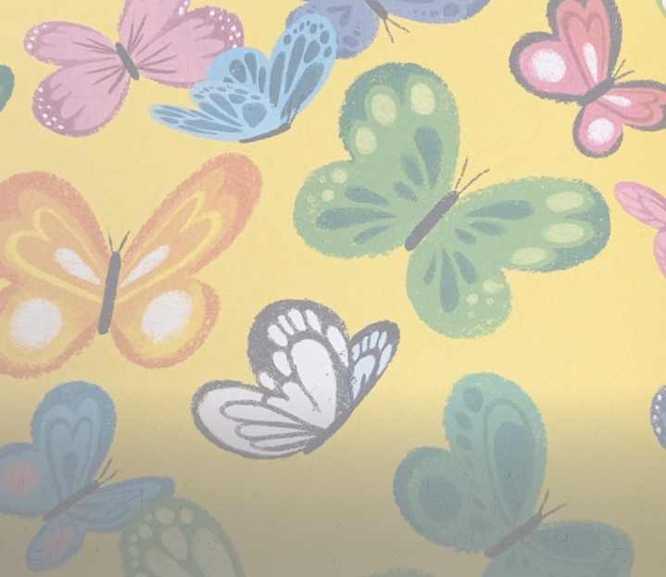
Thinking time…
What are the key messages in this story?

Slide 4
It is normal to feel worried or anxious. People often feel worried about things that they cannot control.
The Worrysaurus developed some strategies to help to free his worry butterfly, including using positive affirmations, having a box of happy things and distracting himself with laughter and fun. It is a good idea to remember that challenging situations do pass.
Can you think of any other strategies that people can use to help them to cope with their worries? What could you do to help free your worry butterfly?

Slide 5
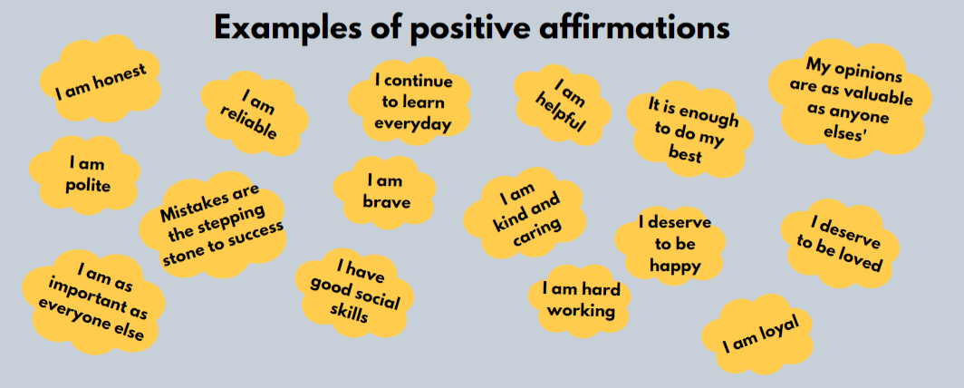
The Power of Positive Thoughts…
Positive affirmations stick in our minds the more we repeat them. Make sure you take time to think about what the affirmation means and notice how it makes you feel. Everyone is different, so your affirmations will be unique to you. Remind yourself of your affirmations daily.
What could yours be?
Taken from @WeHeartCBT

Slide 6
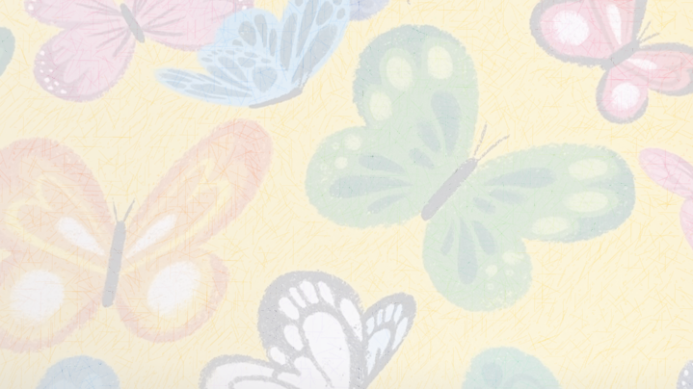
Remember…
You are brilliant and we care about you very much!
If you have a worry, no matter how big or small, you can talk to any of your teachers or speak with Miss Hallam, our school ELSA.

