Slide 1
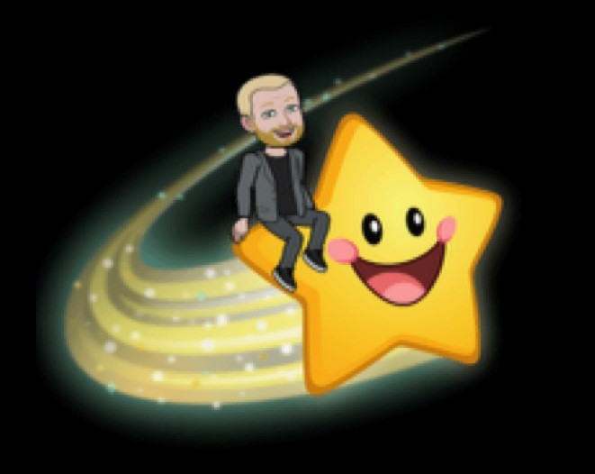

Welcome Fellow Mapplewellians
S.U.C.C.E.S.S
Assembly
S.U.C.C.E.S.S is in our hands
S- self-confidence
U- understanding
C- celebration
C- curiosity
E- excellence, enthusiasm and enjoyment
S- self discipline
S- support

Slide 2
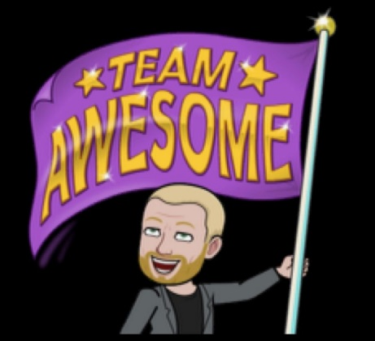


S.U.C.C.E.S.S is in our hands
Hello fellow Mapplewellians and welcome to the SUCCESS assembly.
Every week I will upload the SUCCESS assembly to ClassDojo.
This assembly will be shared in exactly
the same way to all of our Mapplewellians
so it doesn’t matter whether you are
learning remotely at home or in school.

Slide 3


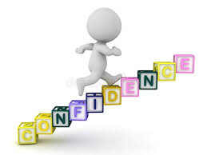

S.U.C.C.E.S.S is in our hands
The focus of today’s assembly is the first S in SUCCESS which stands for self-confidence.
What does ‘self’ mean to you?
What does the word ‘confidence’ mean to you?

Slide 4
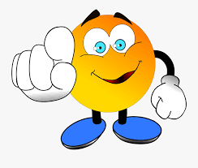
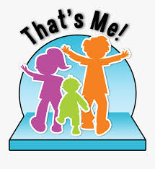


S.U.C.C.E.S.S is in our hands
S- self-confidence
Self is a sense of who you are. It is your identity.
Confidence means feeling sure of yourself and your abilities.

Slide 5
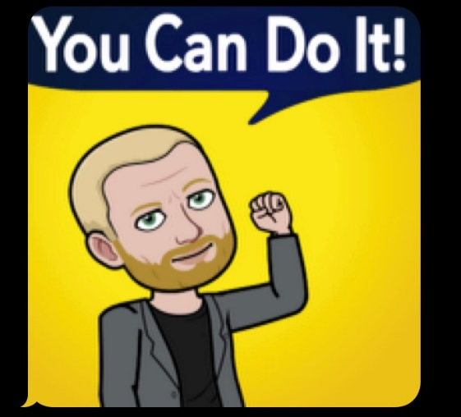

S.U.C.C.E.S.S is in our hands
S- self-confidence
In order further develop self confidence these are my top tips:
1) Accept and be happy with who you are.
2) Understand your strengths.
3) Be positive about the
challenges you face.

Slide 6
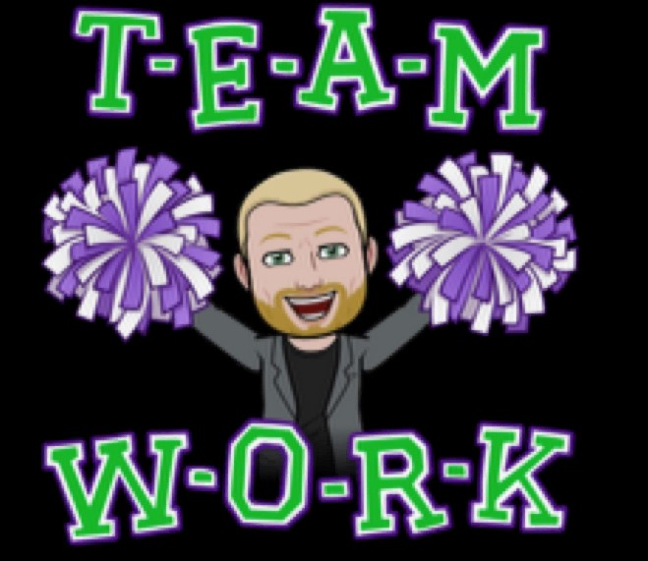

Throughout the week the adults in your class will pick one child to be Star of the week for demonstrating one or more of the S.U.C.C.E.S.S qualities.
This wonderful achievement will be shared on Class Dojo every Thursday.
S.U.C.C.E.S.S is in our hands
S- self-confidence
U- understanding
C- celebration
C- curiosity
E- excellence, enthusiasm and enjoyment
S- self discipline
S- support

Slide 7
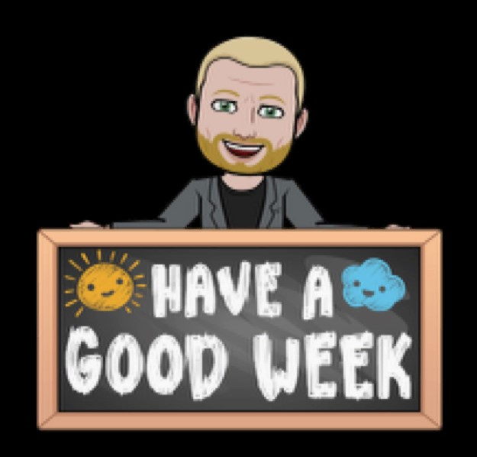
Keep working hard at home or in school Mapplewellians and remember…
S.U.C.C.E.S.S is in
our hands!

