Slide 1

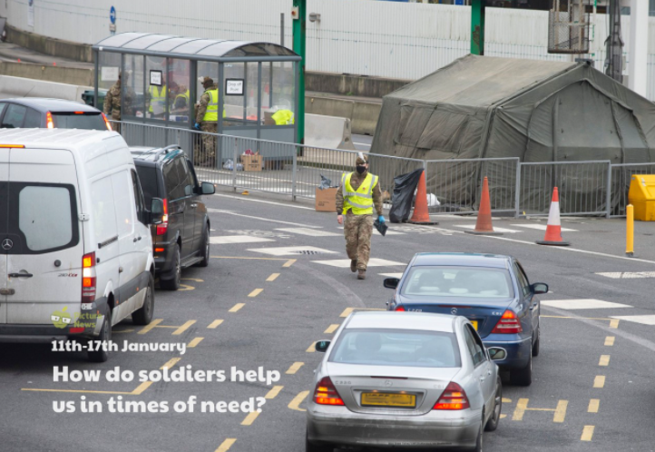
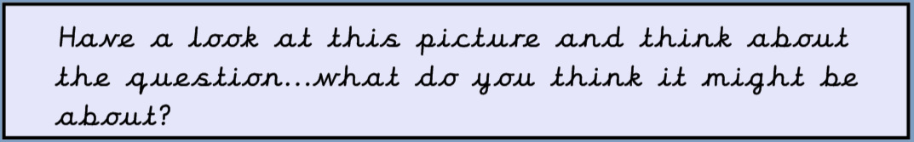

w/c: 11th January 2021

Slide 2
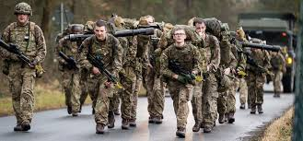
What does this word mean to you?
soldier
A soldier is a person who serves in the Army.
People can join the Army and begin training to be a soldier from the age of 16.
Do you know anyone who is in the army?
What do you think a soldier does?

Slide 3
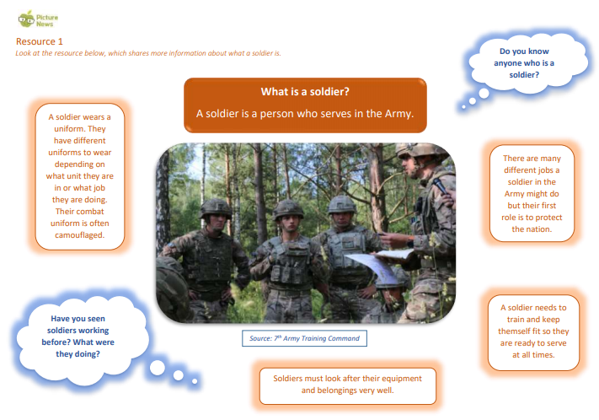
Pause the video and have a look through this page either on your own or with a grown up or older brother or sister.

Slide 4
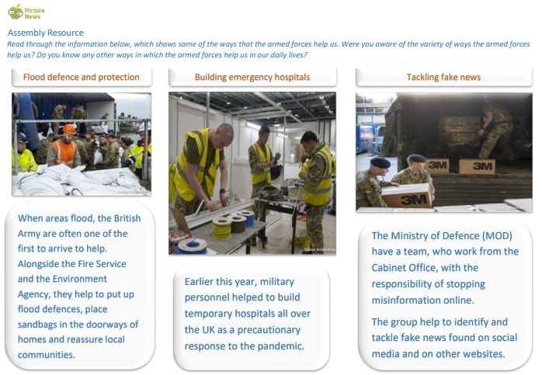
During the Coronavirus pandemic the armed forces have been asked to help with testing, supporting lorry drivers at Dover and in many other ways.

Slide 5


Slide 6
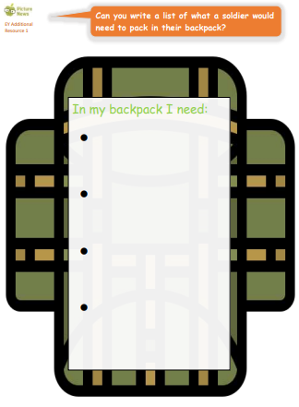
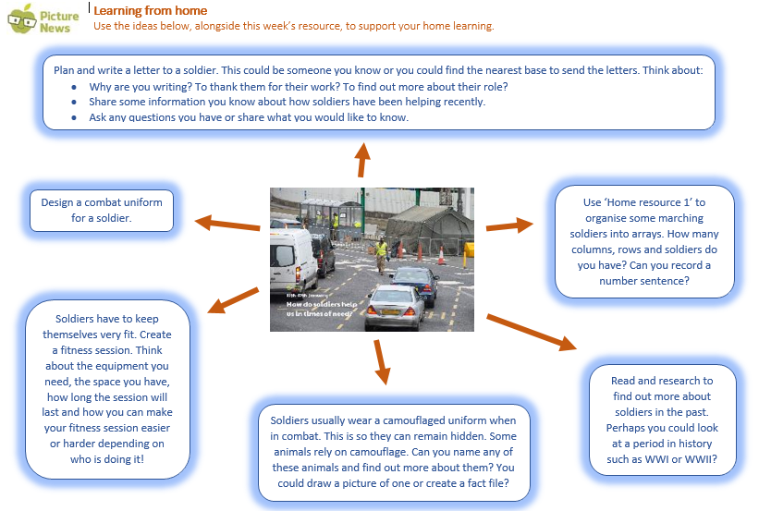

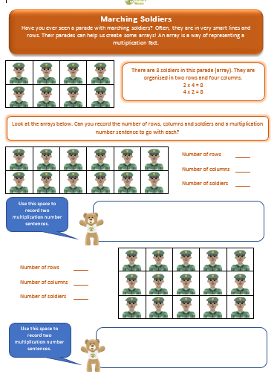
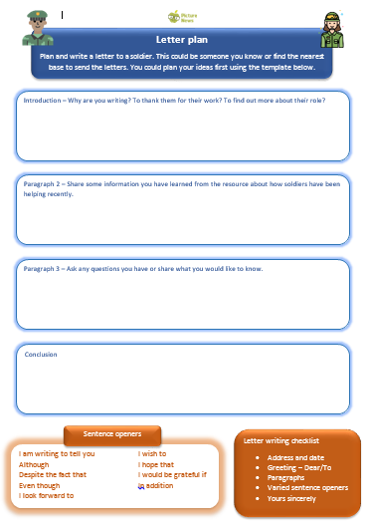
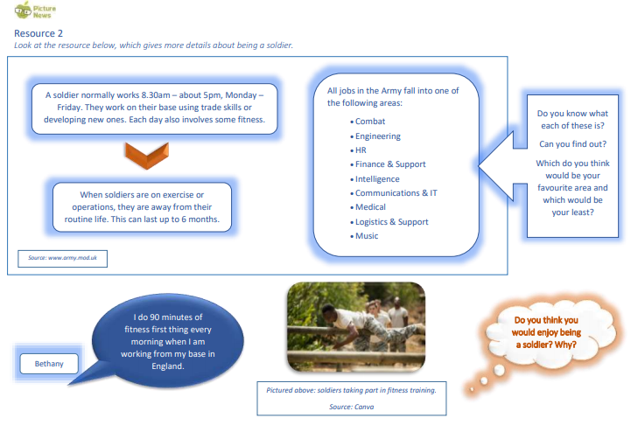
Here are some activities that I will post for you to use along side our assembly…

Slide 7
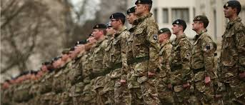
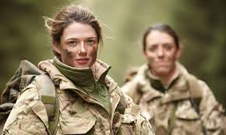
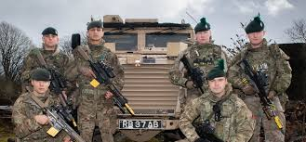
Reflection…
A soldier is someone who serves in the Army.
They wear a uniform and have many different jobs.
A soldier’s day can be very different depending on their role in the Army and whether they are on an operation or not.
Every soldier plays a part in protecting our nation.
This Week’s Useful Vocabulary:
Humanitarian – concerned with or seeking to promote human welfare.
Mass – a large number.
Military – relating to the armed forces of the country. Responsible – having an obligation to do something as part of your job or duty.
Stranded – left without the means to move from somewhere.
Varied – consisting of a number of different types or elements.

