Slide 1


Notes:
I would like to start by celebrating all your fantastic activities in Autumn 2

Slide 2
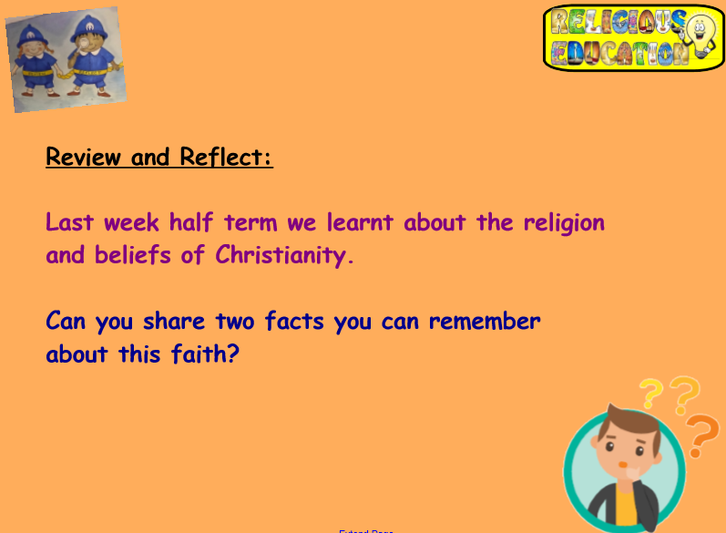
Notes:
I will pause for you to talk about your ideas

Slide 3
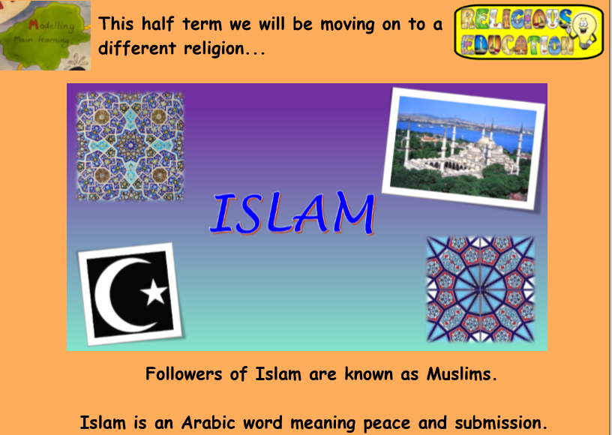
Notes:
The religion of Islam. One of the oldest religions originating from the middle east

Slide 4
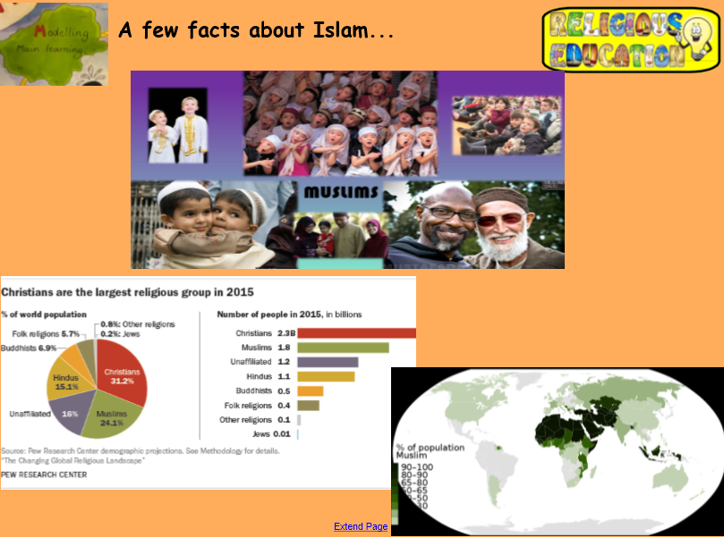

Notes:
Look at the pictures of different people who follow Islam. Muslims live all over the world
Second largest religion

Slide 5
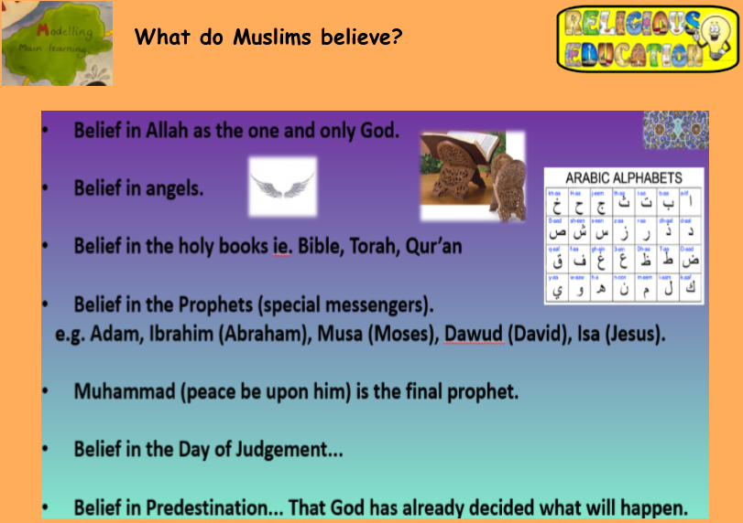


Slide 6
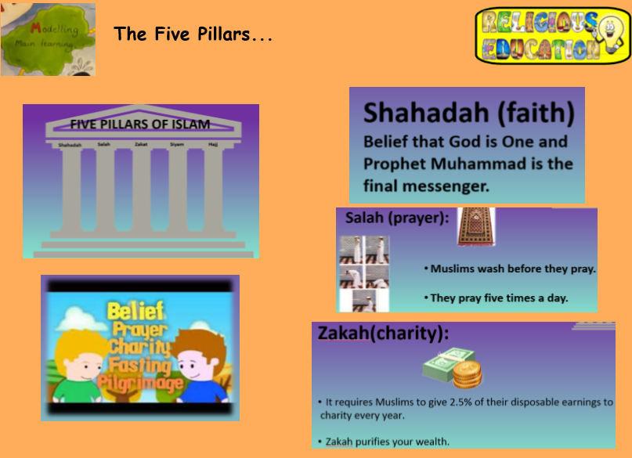

Notes:
These are the main things that Muslim people live by – their main beliefs

Slide 7
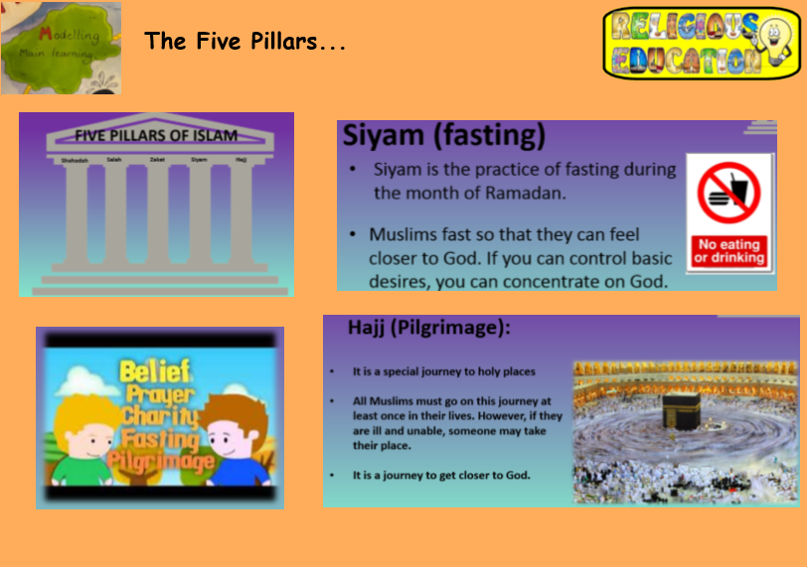


Slide 8
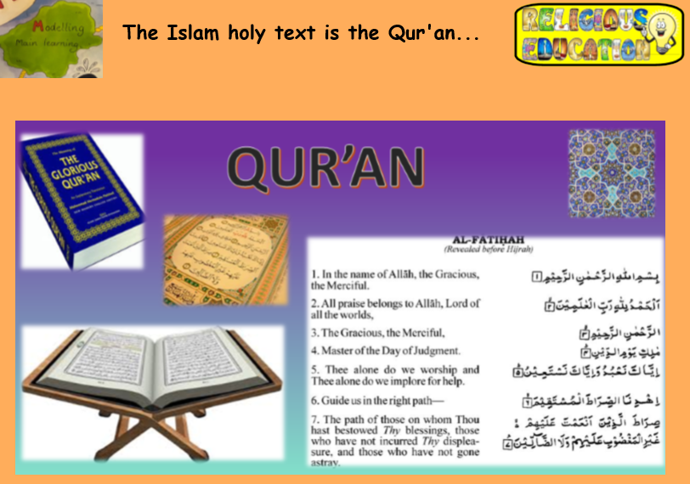
Notes:
What do you notice about the writing in the Quran? It is also written and read from right to left

Slide 9
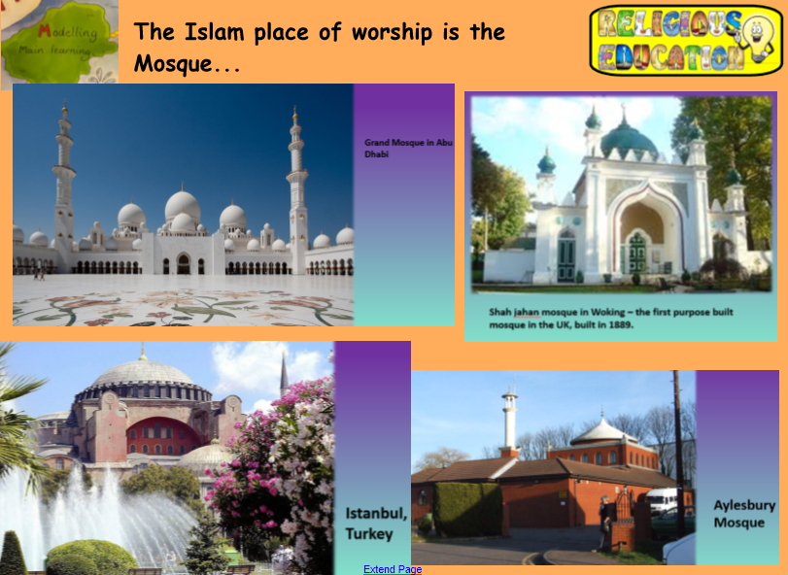


Notes:
Here are some examples of Mosques from around the world – what do you notice about them? What is similar and what is different?
How are they different from places of worship of other religions?

Slide 10
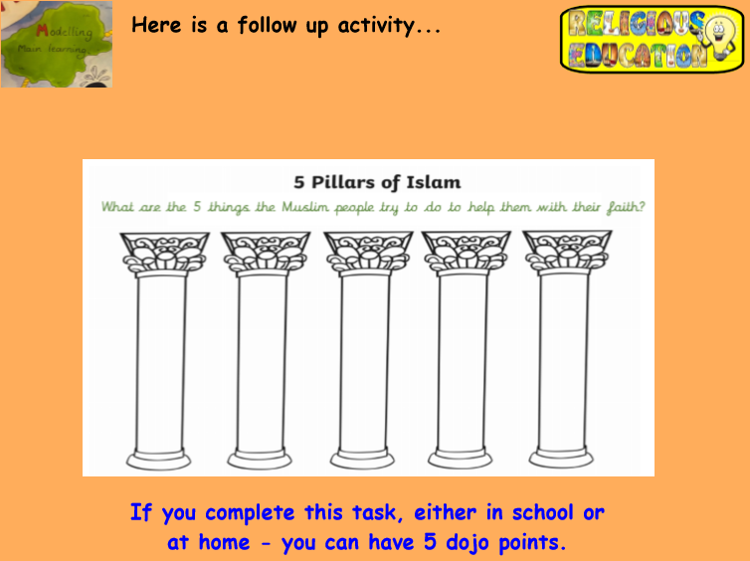
Notes:
This will be attached on the following post

Slide 11
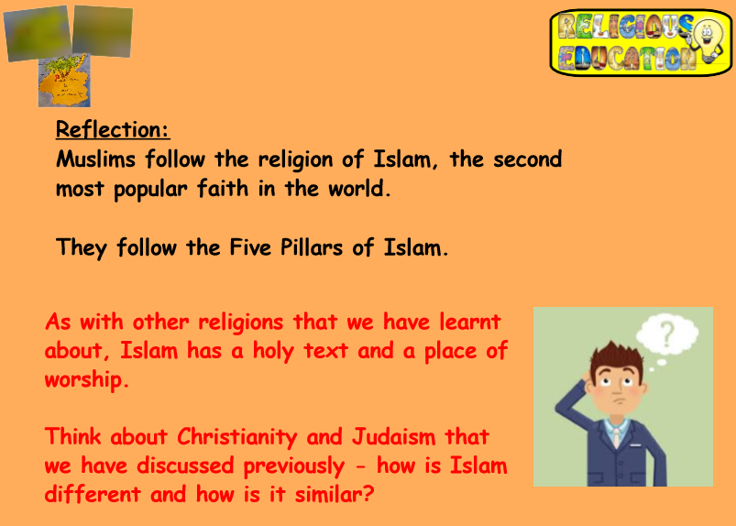
Thank you !
Notes:
Well done for listening and for having your super discussions – thank you, and I look forward to presenting to you again next week

