Slide 1
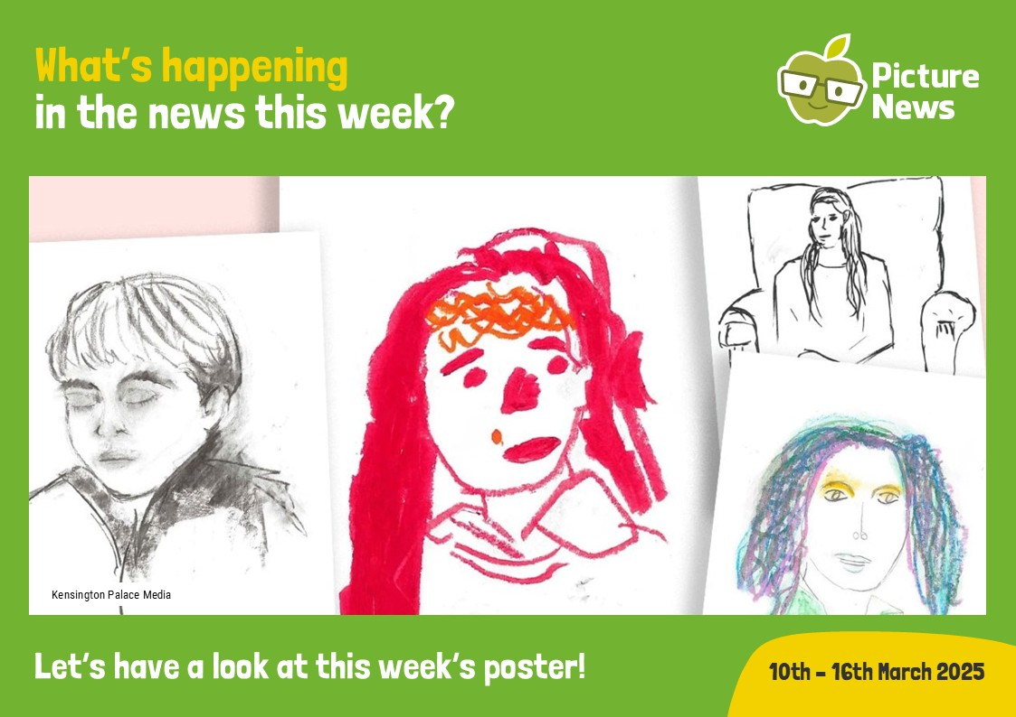

Slide 2
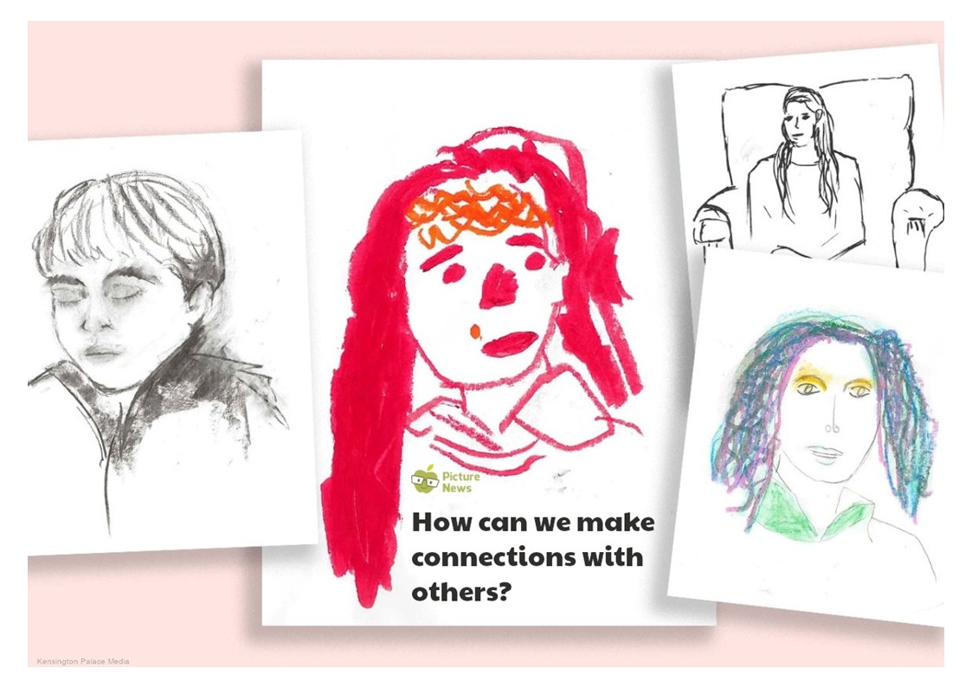
Let’s have a look at this week’s poster!

Slide 3
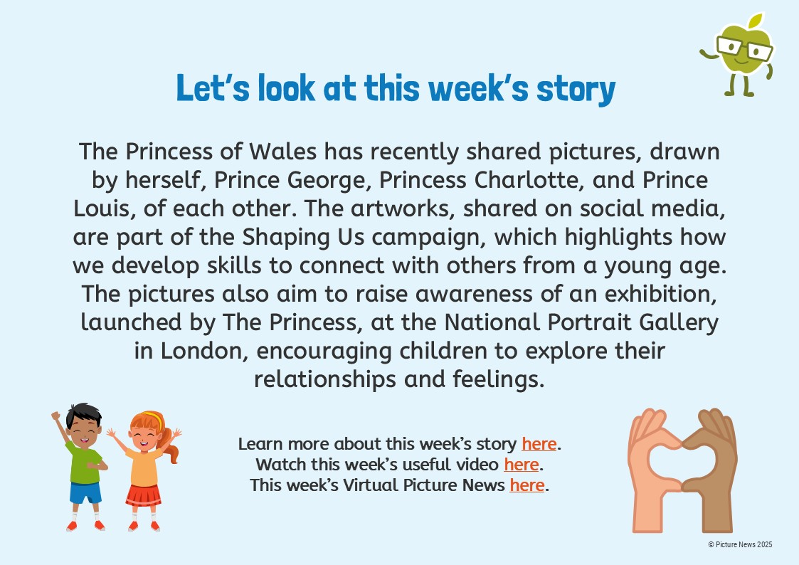

Slide 4
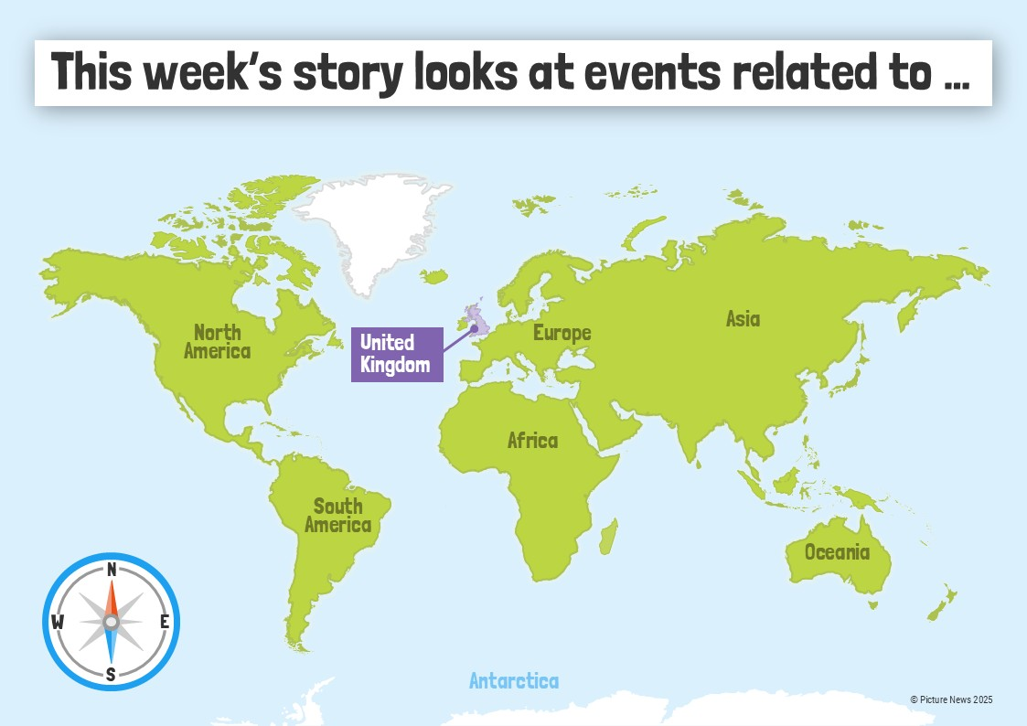

Slide 5
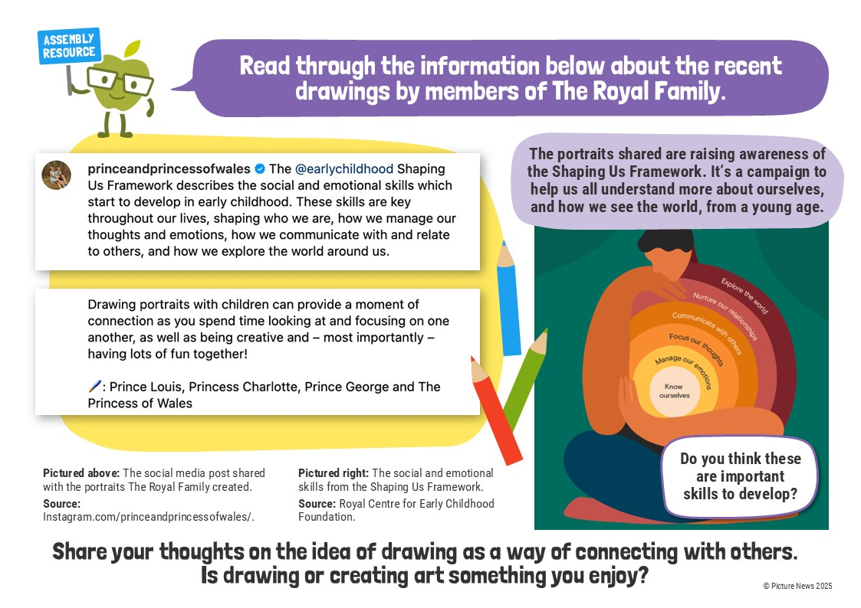

Slide 6


Slide 7
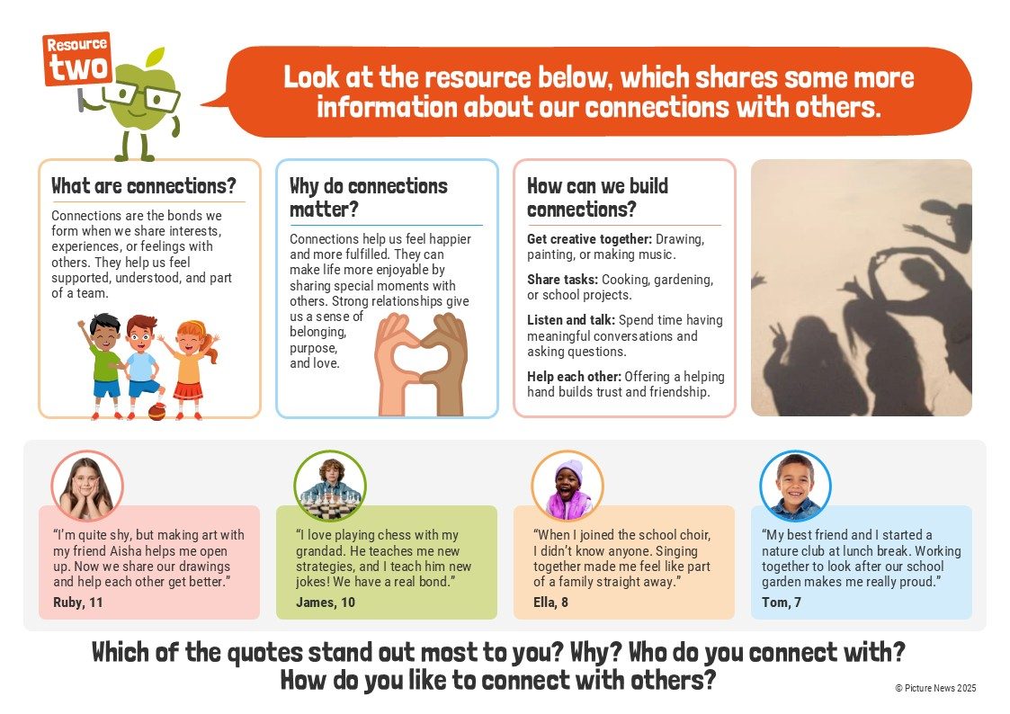

Slide 9


Slide 10
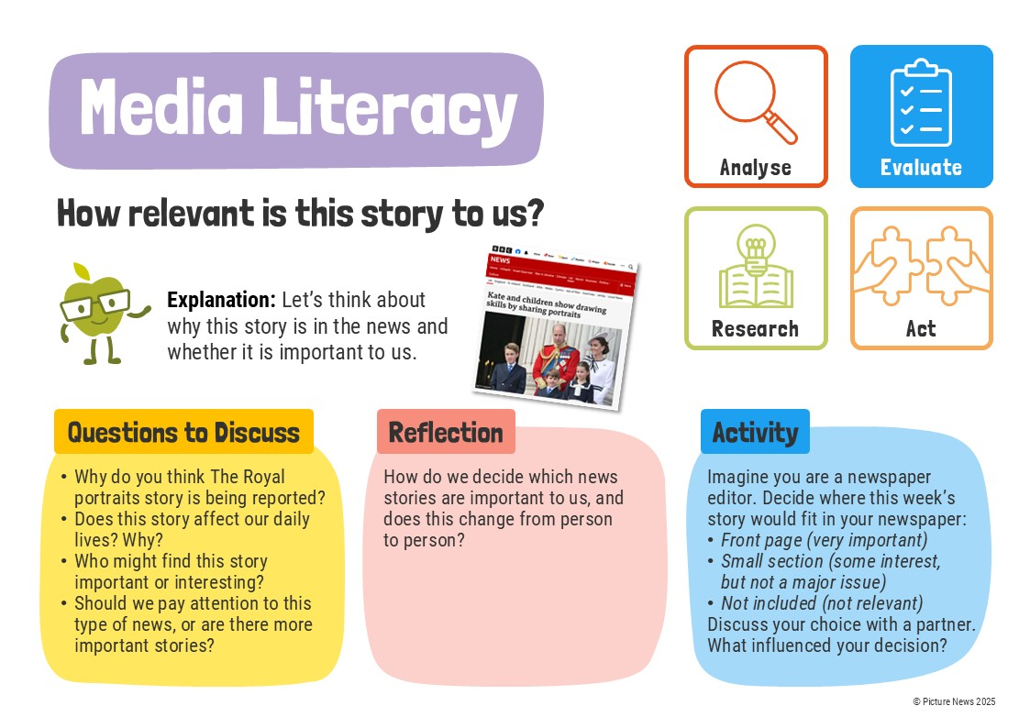

Slide 11


Slide 12


Slide 13


Slide 14


