Slide 1


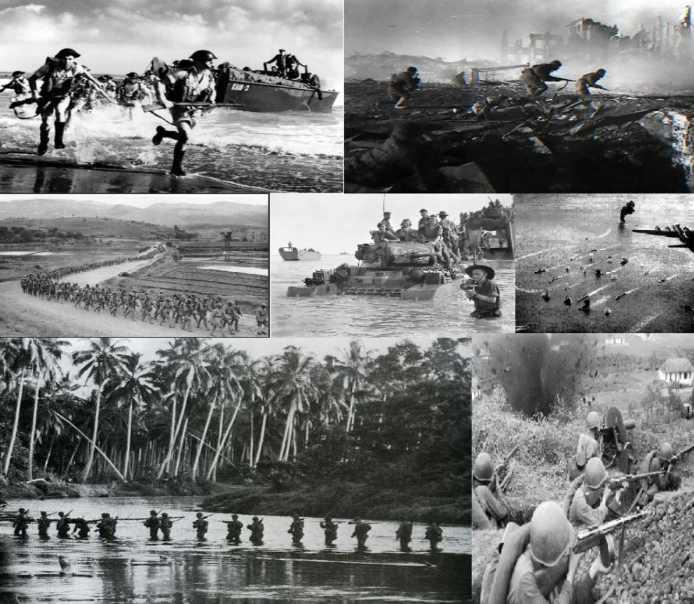
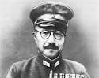
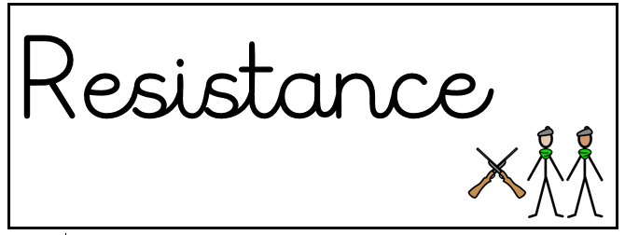

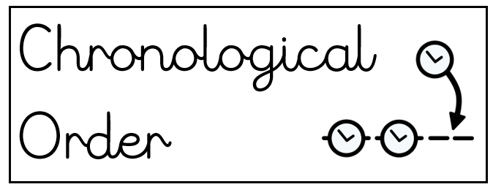
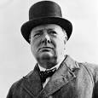
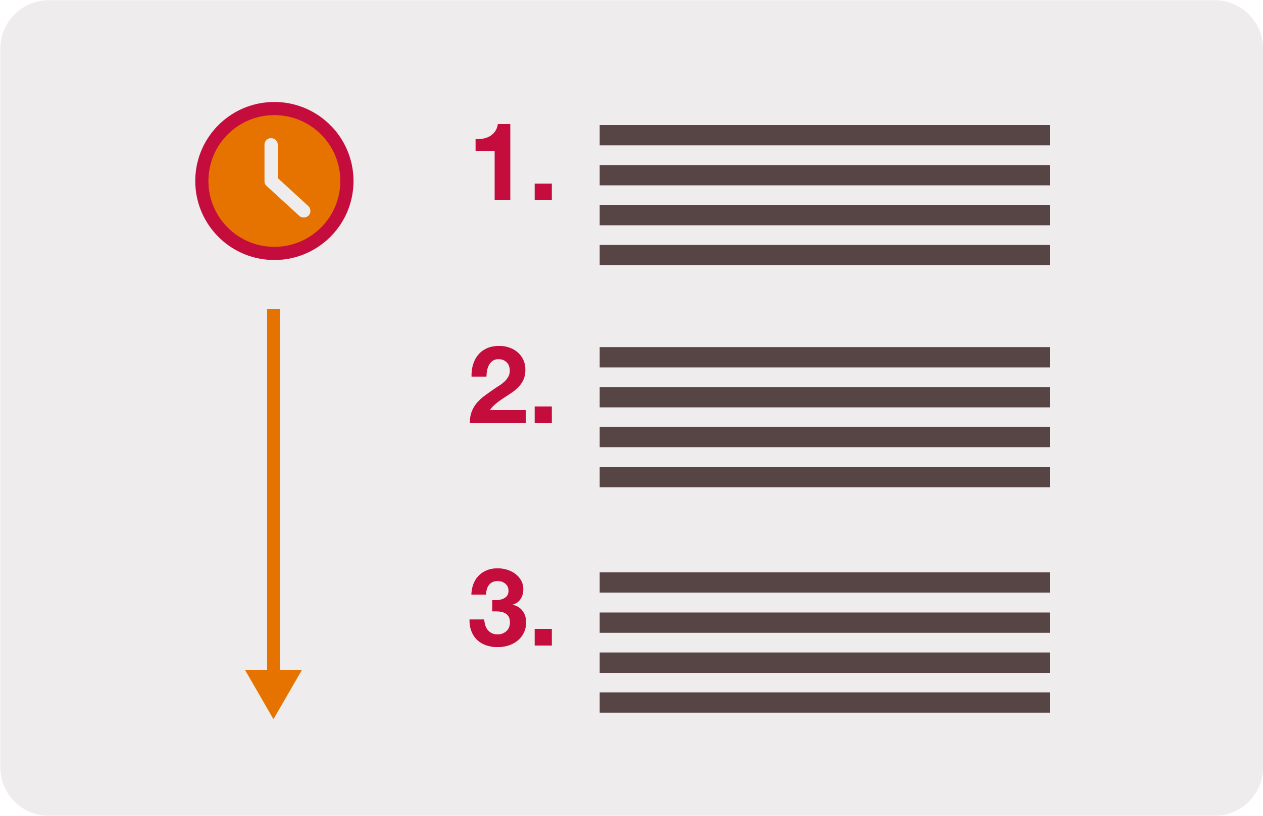


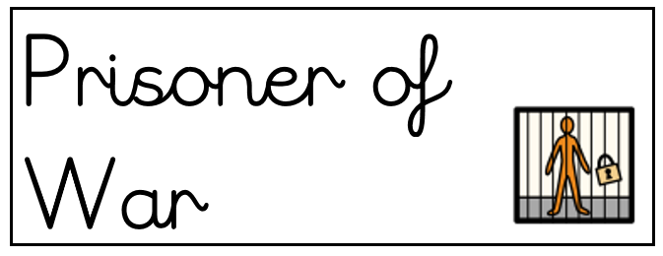
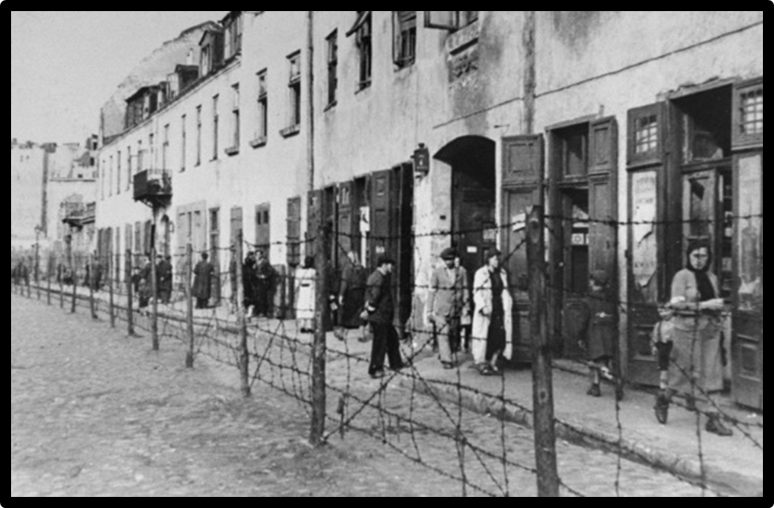
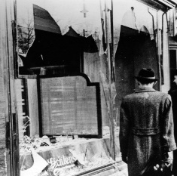

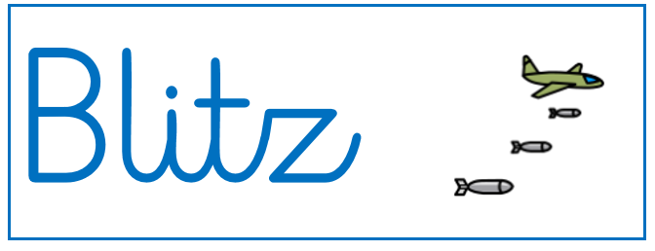

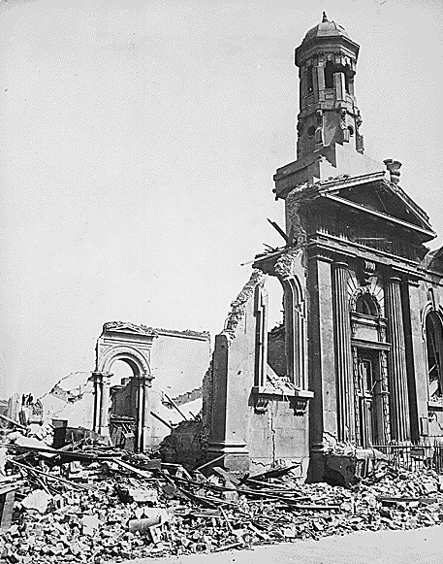
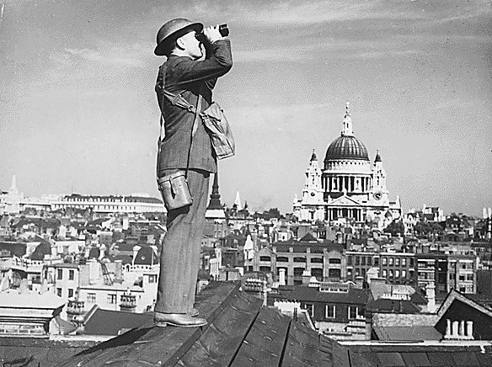
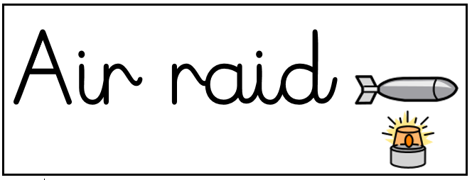


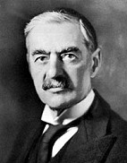
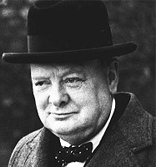
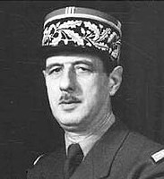
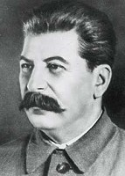
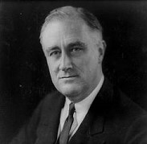
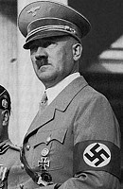
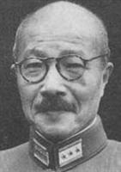
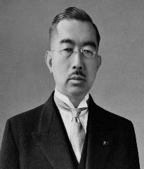
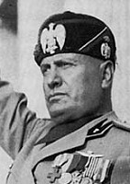
Years 5 and 6 – Autumn Term – History- How can we learn from our mistakes?
Key Knowledge
Chronological order is the arrangement of things following one after another in time
Key Knowledge
The major Axis powers were Nazi Germany, Italy and Japan.
Key Knowledge
WWII began on September 1st 1939. WWII ended on September 2nd 1945.
Key Knowledge
The major Allied powers were Britain, France, Russia, and the United States of America.
.
Key Knowledge
The Battle of Britain was the first ever battle to be fought only in the air using aeroplanes.
Key Knowledge
Hitler had extreme anti-Semitic beliefs, which meant that he wanted to eradicate Jewish people.
Allies Significant People Axis
Neville Chamberlin Winston Churchill Charles de Gaulle Joseph Stalin F.D Roosevelt | Adolf Hitler Hideki Tojo Emperor Hirohito Benito Mussolini

Slide 2

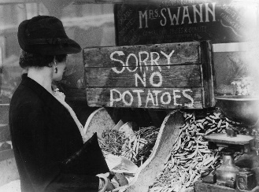


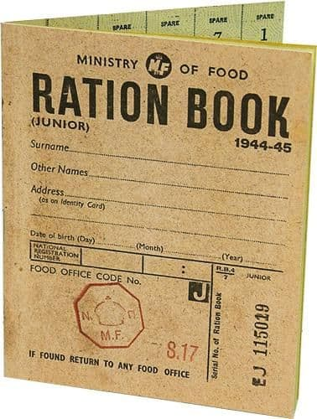
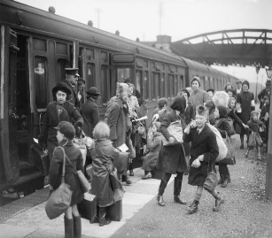
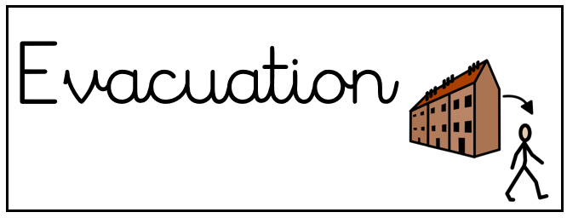
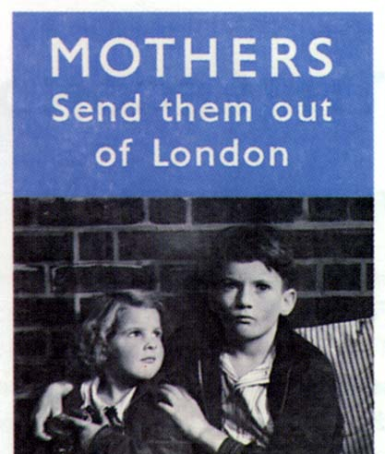

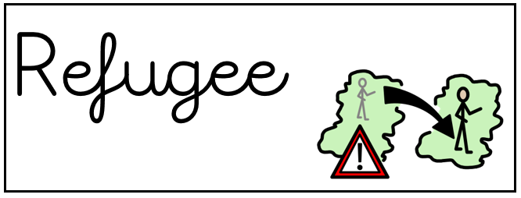
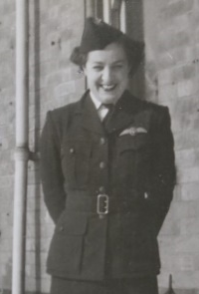
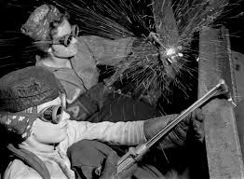


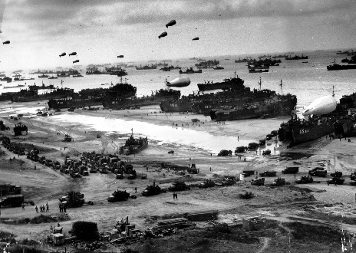
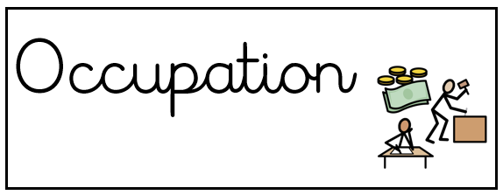

Years 5 and 6 – Autumn Term – History- How can we learn from our mistakes?
Key Knowledge
Propaganda is a method of spreading information to persuade people to think or act in a certain way.
Key Knowledge
During the war, children had to be evacuated from big cities to the countryside where it was safer.
Key Knowledge
Extreme changes in living such as rationing were needed due to the war.
Key Knowledge
Some women worked had to work with the armed forces such as Eleanor Wadsworth.
Key Knowledge
There were many events that led to the end of the war rather than a sudden end.
Key Knowledge
Women were employed to do a range of jobs during the war while men went off to war

